Slide 1


Sleep Tracking
using ML
PRESENTED BY
MANIKANTA PANUGANTI
UNDER THE GUIDANCE OF PROF.DR. CHAOJIE (JAY) WANG
NOVEMBER 27 2023
Notes:
A research has conducted in 2017 which revealed that
more than 50 million americans have chronic sleep disorders that is more than 7 percentage
Although most adults 7-9 hours of sleep per night , more than 35% all adults in the United States report sleeping less than the minimum.
As many of us can relate, sleep is not just a luxury; it's a fundamental factor influencing our health and performance. So, how can we effectively track it?
There are multiple ways to track sleep. The gold-standard method for quantifying sleep and quality is polysomnography (PSG).
PSG requires signals from multiple sensors, as well as expert input.
Brain waves.
Eye movements.
Heart rate.
Breathing pattern.
Blood oxygen level.
Prices can range from $1,000 to over $10,000
An alternative method, which is more practical and widely used, is actigraphy. This involves the use of motion sensors, often found in smartwatches, to detect sleeping patterns. By tracking hand movements, actigraphy provides valuable insights into sleep-wake cycles.
EEG and Heart rate.
Dataset is from Healthy brain network. They have conducted a study on sleeping patterns. They had a subject who worn a accelorometer for over an year and collected data from it and a single row looks liks this

Slide 2

Sleep Tracking
1. Motivation
2. Techniques
3. Data Overview
4. EDA and Feature Engineering
5. Modelling
6. Results
7. Conclusion

Slide 3
50M
50 Million Americans have chronic sleep disorders
An estimated 35 percent of Americans report their sleep quality as “poor” or “only fair.”
Notes:
A research has conducted in 2017 which revealed that
more than 50 million americans have chronic sleep disorders that is more than 7 percentage
Although most adults 7-9 hours of sleep per night , more than 35% all adults in the United States report sleeping less than the minimum.
As many of us can relate, sleep is not just a luxury; it's a fundamental factor influencing our health and performance. So, how can we effectively track it?

Slide 4
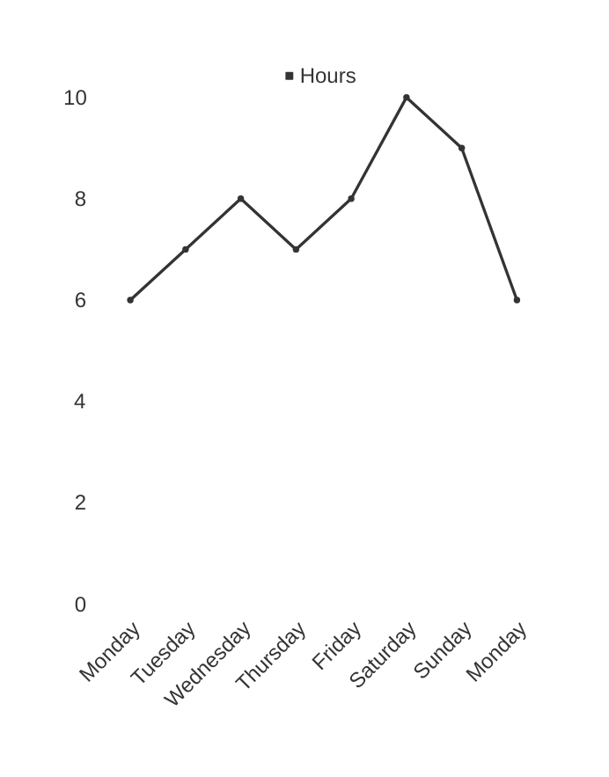
Techniques
Polysomnography (PSG)
Actigraphy
Heart Rate Variability (HRV)
Electroencephalography (EEG)
Time
Notes:
There are multiple ways to track sleep. The gold-standard method for quantifying sleep and quality is polysomnography (PSG).
PSG requires signals from multiple sensors, as well as expert input.
Brain waves.
Eye movements.
Heart rate.
Breathing pattern.
Blood oxygen level.
Prices can range from $1,000 to over $10,000
An alternative method, which is more practical and widely used, is actigraphy. This involves the use of motion sensors, often found in smartwatches, to detect sleeping patterns. By tracking hand movements, actigraphy provides valuable insights into sleep-wake cycles.
EEG and Heart rate.

Slide 5
Dataset
Time stamp | anglez | enmo | awake/sleep
2017-11-09T19:00:00 | -5.5902 | 0.1751 | 0
Healthy brain network
13 Million data points
Notes:
Dataset is from Healthy brain network. They have conducted a study on sleeping patterns. They had a subject who worn a accelorometer for over an year and collected data from it and a single row looks liks this

Slide 6
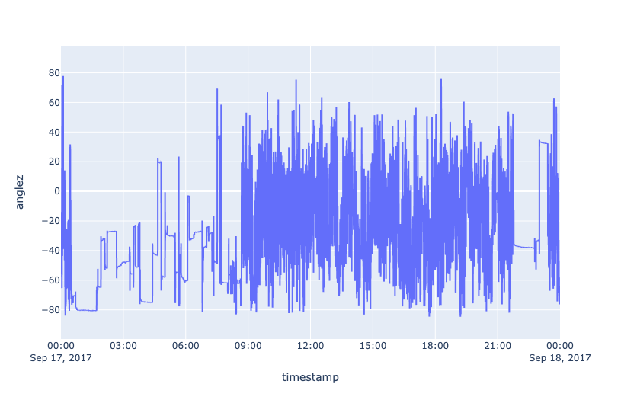
EDA and Feature Engineering
Time

Slide 7
Feature Engineering
Date Time Features
Hour, Weekday etc..
Window statistics features
rolling mean, std, etc..

Slide 8
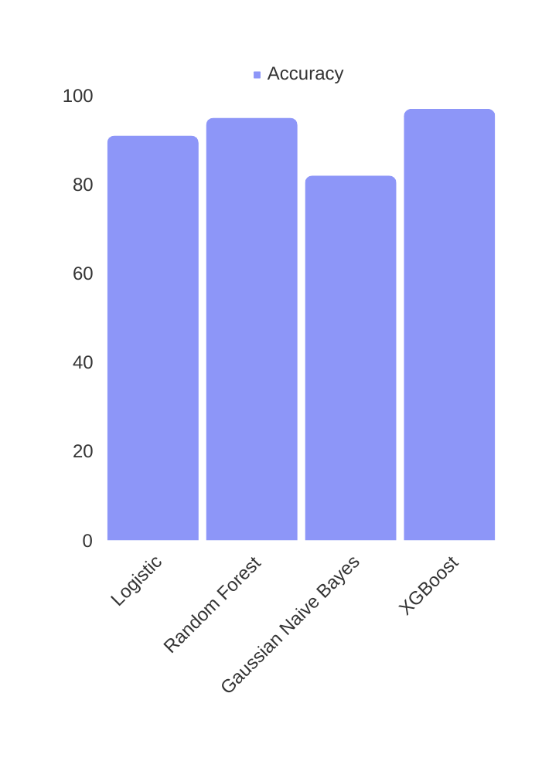
Modelling
Accuracy

Slide 9
https://sleepai.streamlit.app/

Slide 10
Conclusion
A system to track sleep.
Importance of feature Engineering.
Can improve the system to track sleeping stages.
Different models i.e Neural Networks RNN, LSTM, etc..
We can add different data sources.

Slide 11
Thank you!

